Slide 1



Slide 2


Intent APIs in Cisco DNA-Center
Mariusz Kaźmierski, Technical Leader, EMEAR CX
DEVNET-2087

Slide 3

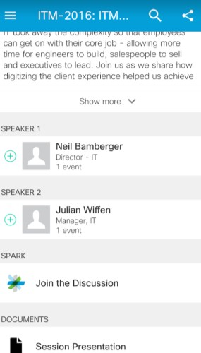



Cisco Webex Teams
Questions?
Use Cisco Webex Teams to chat
with the speaker after the session
How
Find this session in the Cisco Live Mobile App
Click “Join the Discussion”
Install Webex Teams or go directly to the team space
Enter messages/questions in the team space
Webex Teams will be moderated by the speaker until June 16, 2019.
cs.co/ciscolivebot#DEVNET-2087
#CLUS
© 2019 Cisco and/or its affiliates. All rights reserved. Cisco Public
3

Slide 4
Agenda
Cisco DNA Center Platform
Intent API - overview
Intent API – how to use?
Intent API – demo
References
DEVNET-2087
10

Slide 5
What’s in it for me?
In this session | Out of scope
Cisco DNA-Center Platform overview | Cisco DNA-Center basics
How to start & basic API examples | Advanced API examples
Live demo during the session | Troubleshooting & debugging
Target audience is technical attendees knowing the basics of Cisco DNA-Center and looking for overview and basic understanding how to start and effectively use APIs
in Cisco DNA-Center.
DEVNET-2087
10

Slide 6
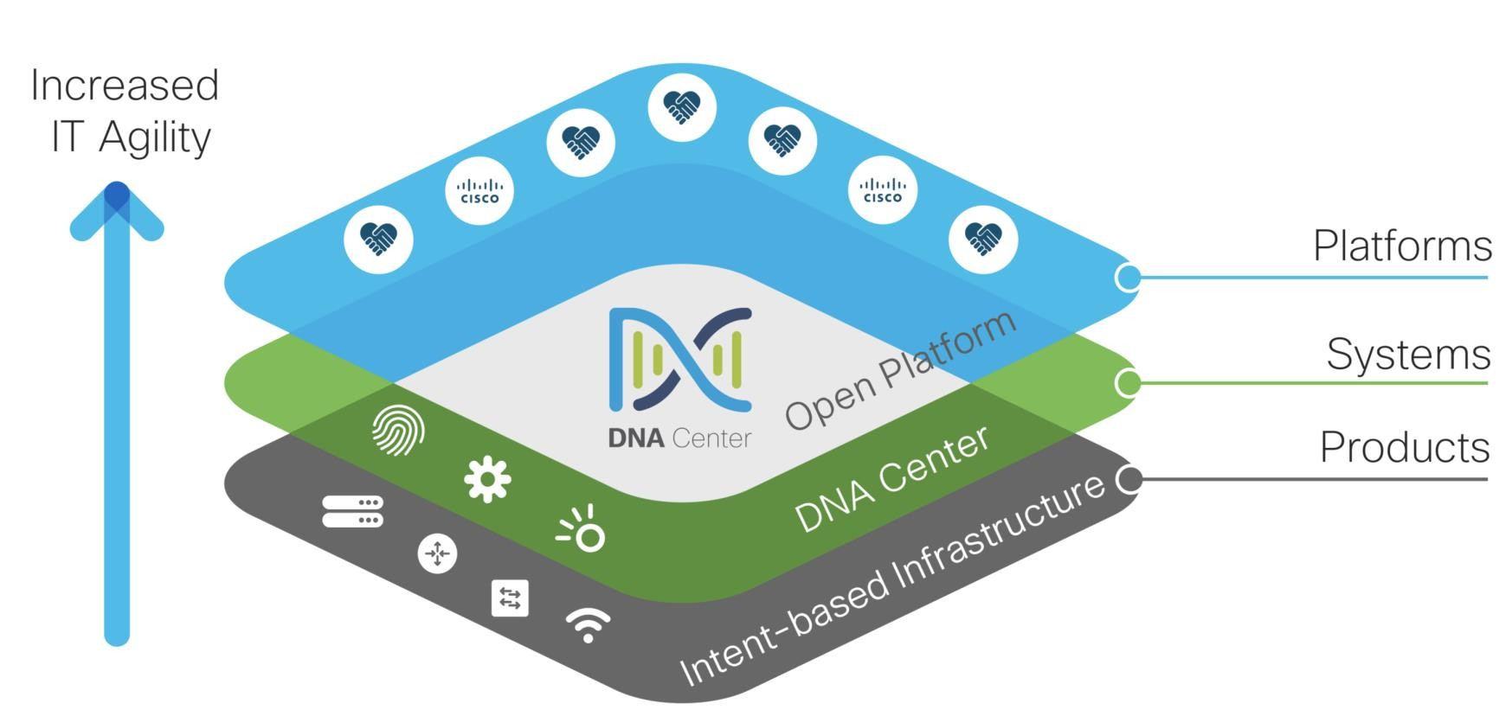
Cisco DNA – from products to platforms
DEVNET-2087
10

Slide 7
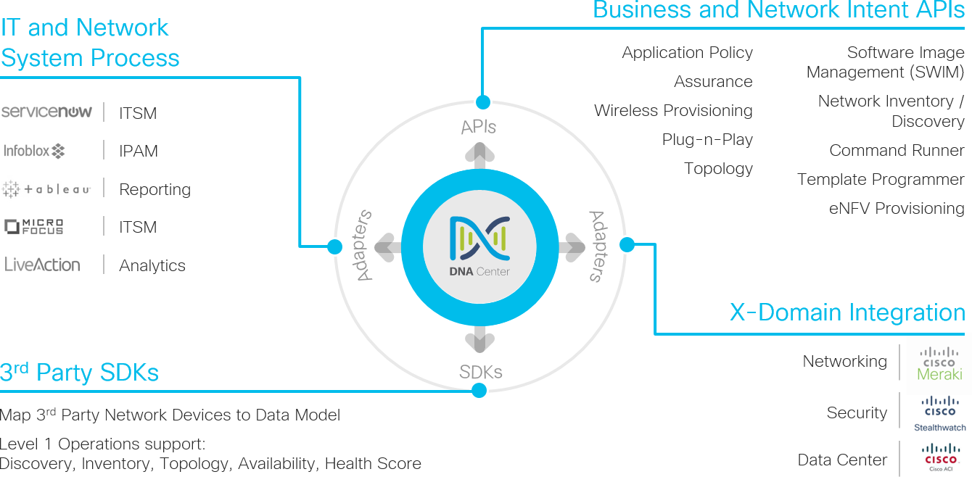
Cisco DNA Center Platform Overview
DEVNET-2087
10

Slide 8
Cisco DNA Center Platform Overview
DEVNET-2087
10

Slide 9
Cisco DNA Center – Intent API
Intent API:
exposes specific capabilities of Cisco DNA Center Platform (Northbound REST API),
provides policy-based abstraction of business intent, allowing you to focus on the outcome to achieve,
allows you to use HTTPS verbs (GET, POST, PUT, and DELETE) and JSON syntax to discover and control your network.
DEVNET-2087
10

Slide 10
Intent API – purpose - why should I care?
Enhance the overall network experience by:
optimizing end-to-end IT processes,
reducing Total Cost of Ownership (TCO),
developing new value-added network solutions.
DEVNET-2087
10

Slide 11
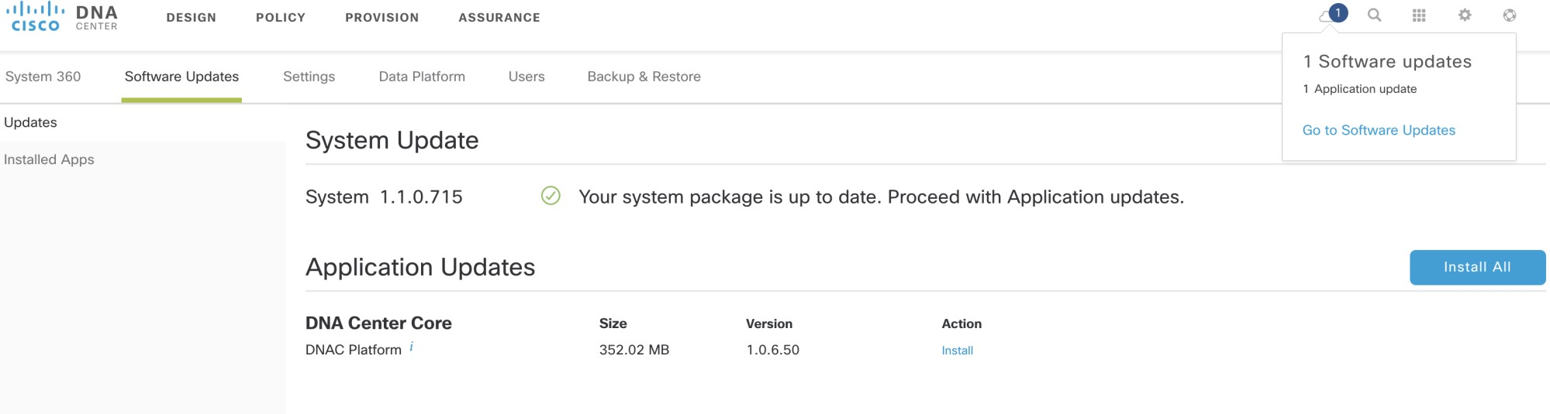
Cisco DNA Center Platform - installation
1
2
DEVNET-2087
10

Slide 12
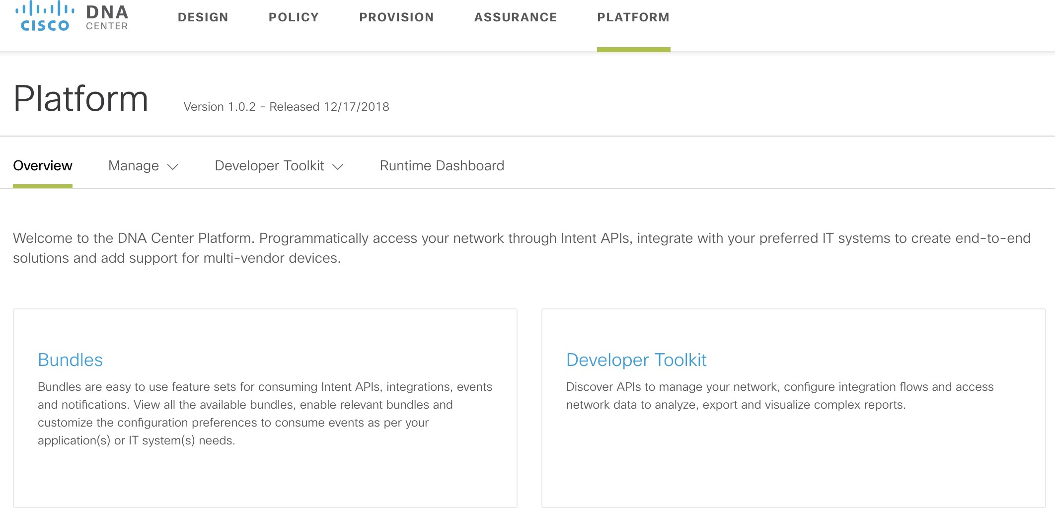
Cisco DNA Center Platform – API activation
1
2
DEVNET-2087
10

Slide 13
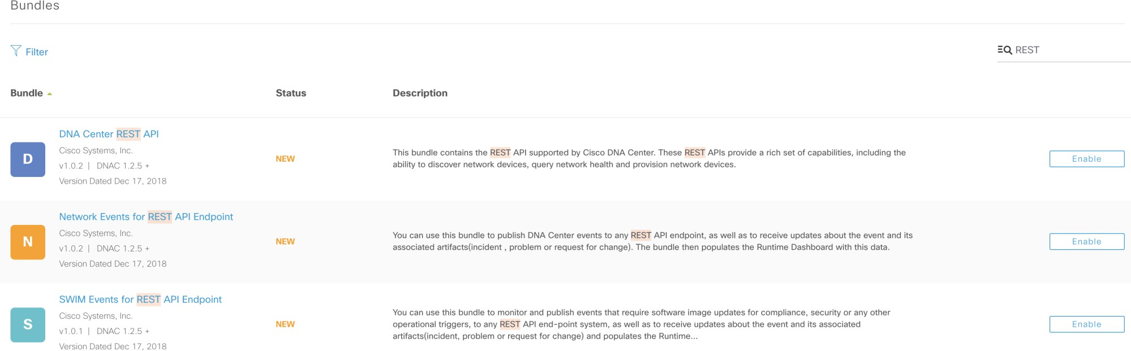
Cisco DNA Center Platform - API activation
1
Enable REST API Bundle
DEVNET-2087
10

Slide 14
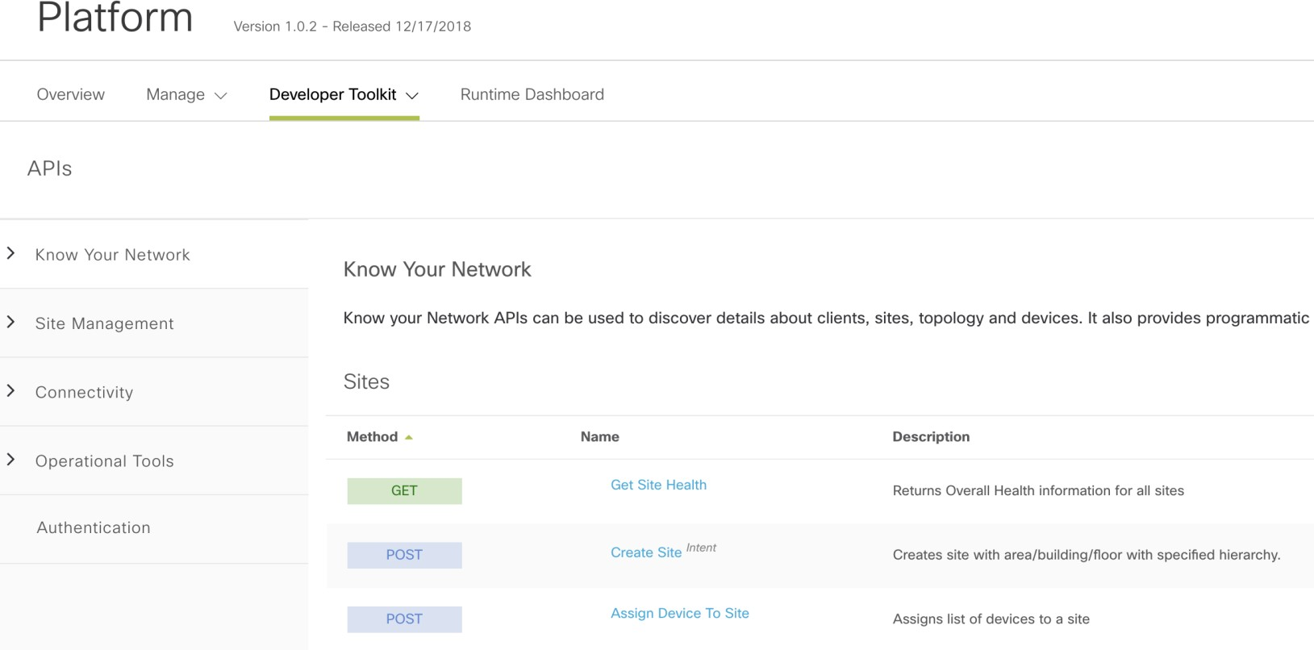
Cisco DNA Center Platform - API Overview
1
Click to see documentation and
test API.
2
DEVNET-2087
10

Slide 15
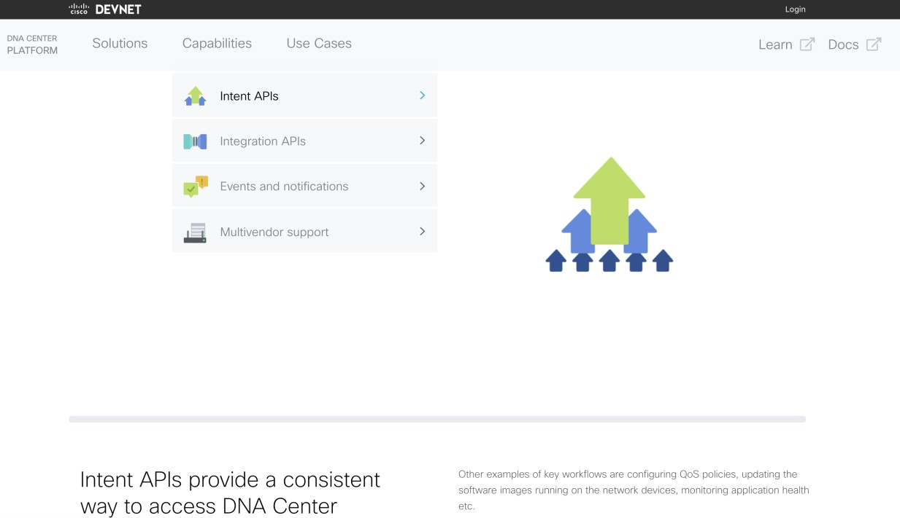
API online documentation - DevNet
https://developer.cisco.com/dnacenter/intentapis/
DEVNET-2087
10

Slide 16
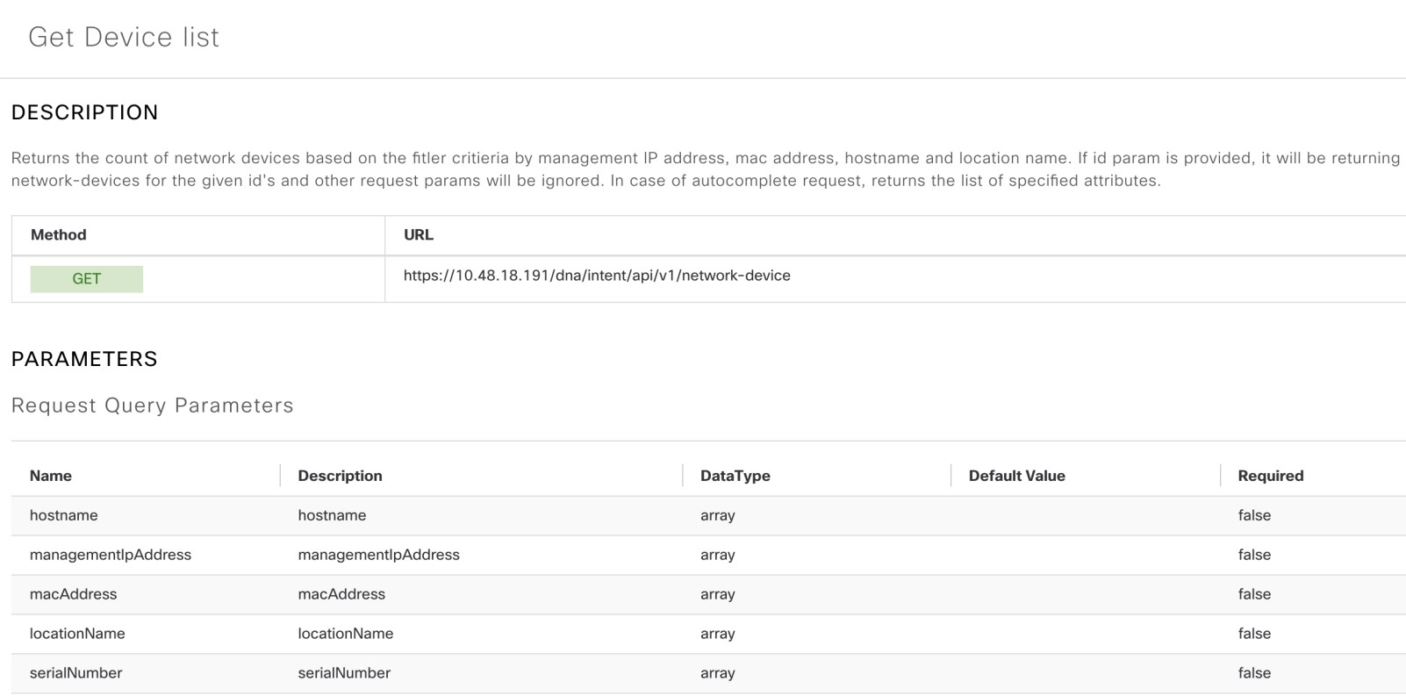
API built-in documentation
DEVNET-2087
10

Slide 17
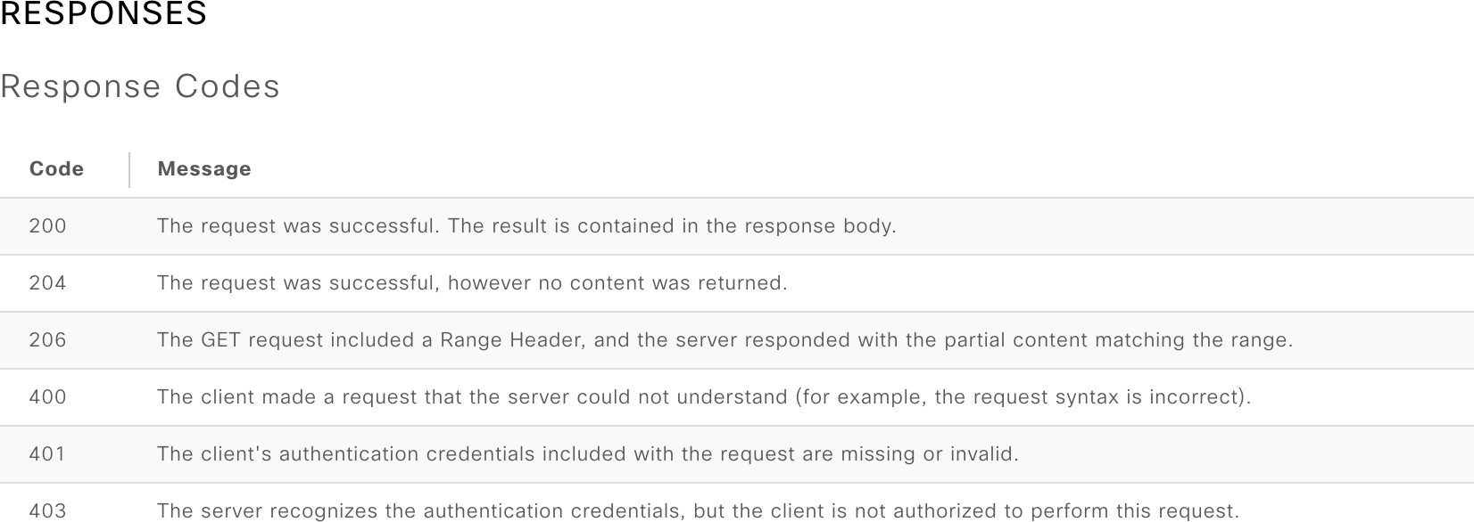
API built-in documentation
DEVNET-2087
10

Slide 18
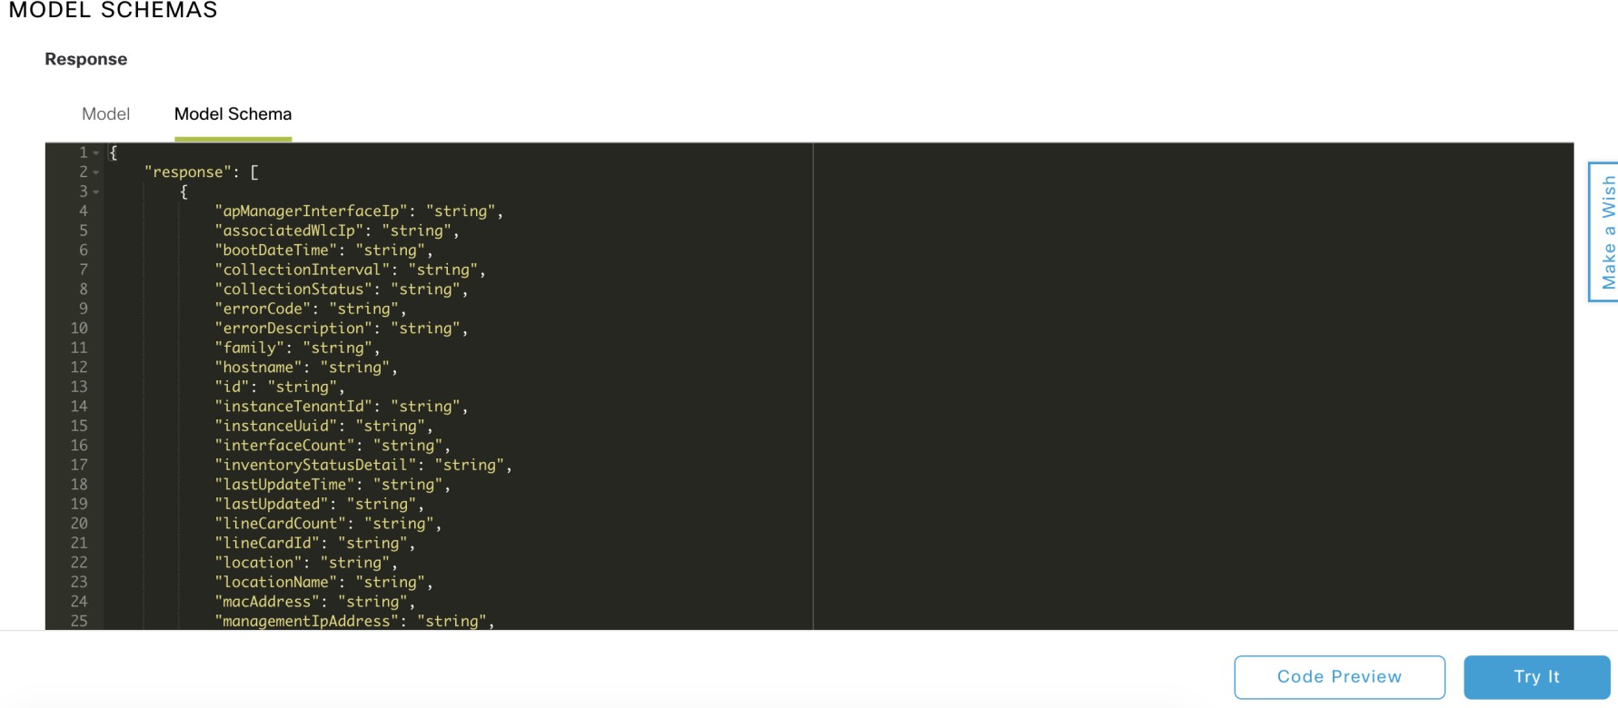
API – model schemas
2
Click to run API.
1 Click to get code snippet
DEVNET-2087
10

Slide 19
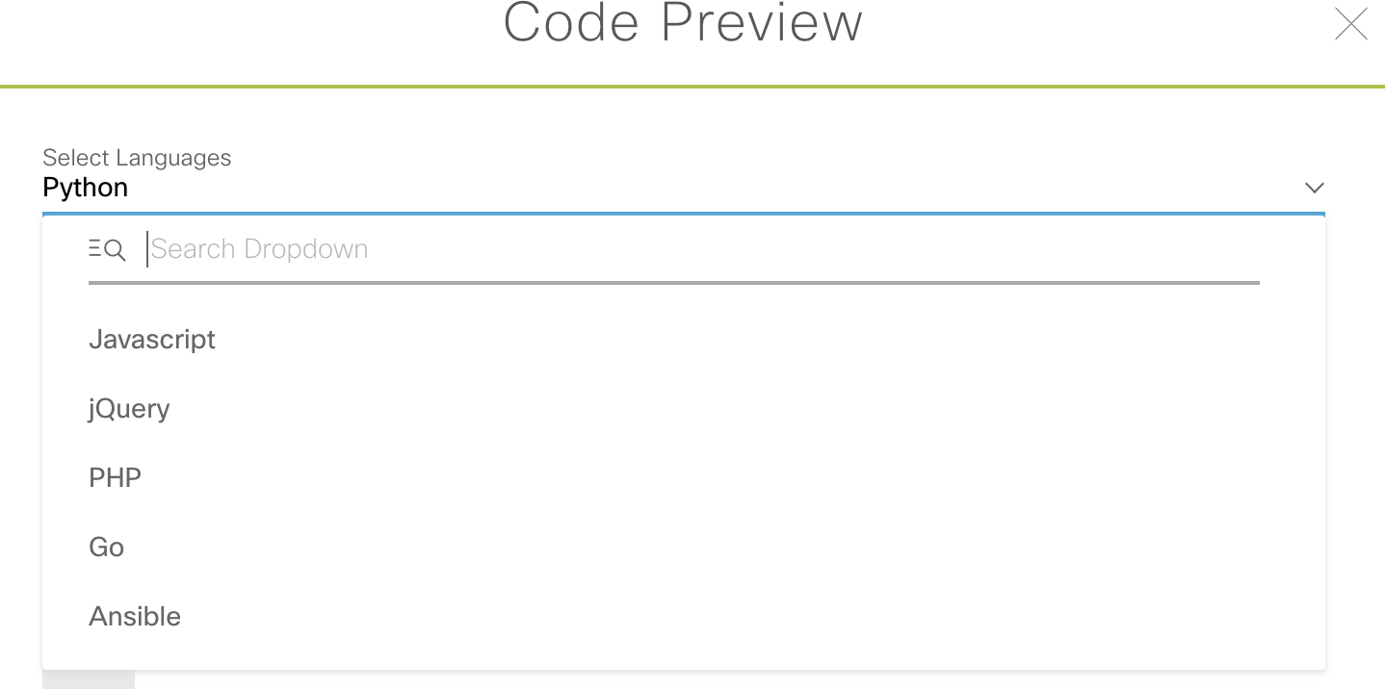
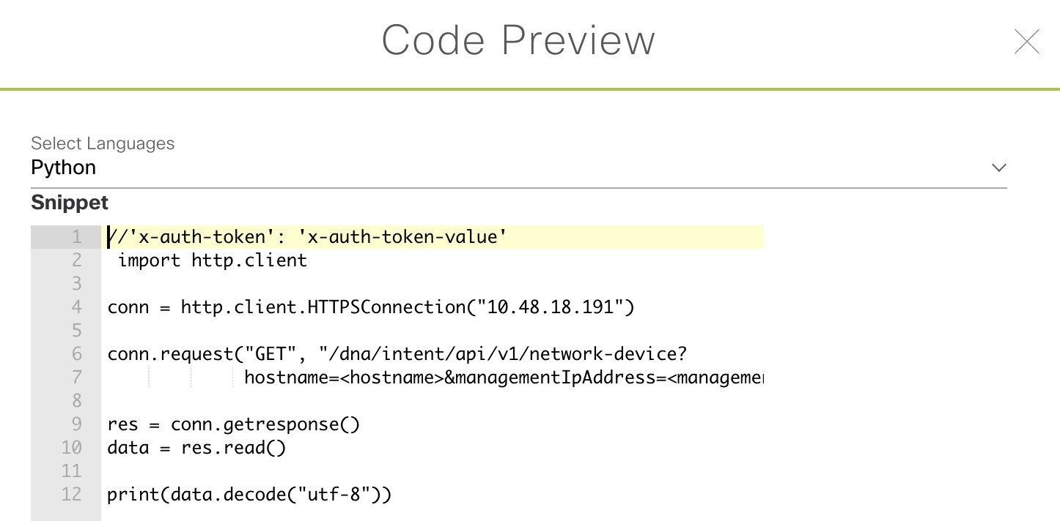
How to run API calls?
Option 1 – code snippets
Available also in: JavaScript, Go, Ruby, jQuery, Ansible, Shell, …
DEVNET-2087

Slide 20
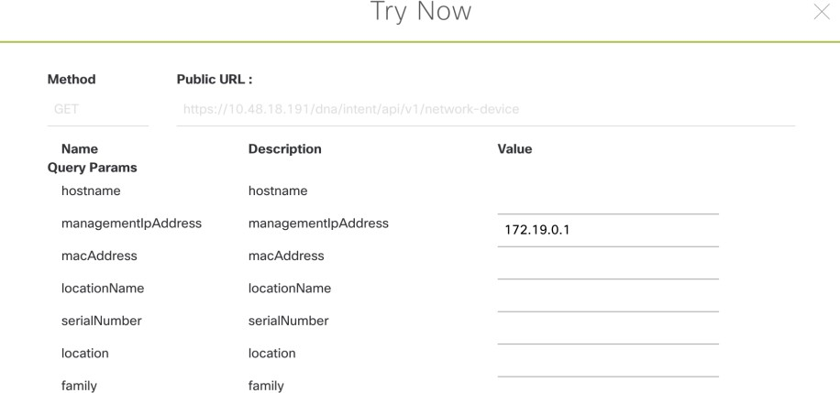
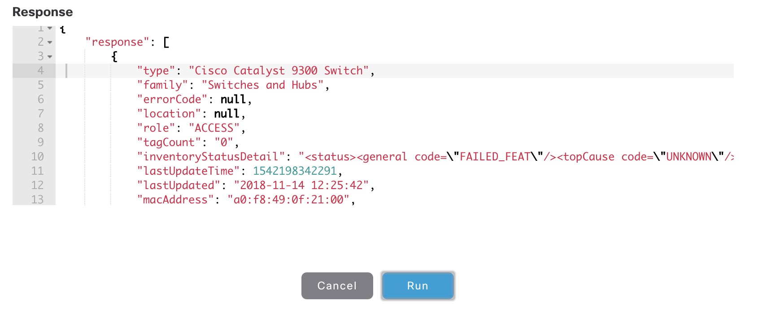
How to run API calls?
Option 2 – ”try it now” functionality
DEVNET-2087

Slide 21

How to run API calls?
Option 3 – CURL / Postman
$ curl --insecure
--request POST
--header "Authorization: Basic $(echo -n api:CiscoLive2019 https://10.48.18.192/dna/system/api/v1/auth/token
| base64)"
{"Token":"eyJ0eXAiOiJKV1QiLCJhbGciOiJIUzI1NiJ9.eyJzdWIiOiI1YmYxZWI0MjRjZjFjMzAwYjI1YWJiYTk iLCJhdXRoU291cmNlIjoiaW50ZXJuYWwiLCJ0ZW5hbnROYW1lIjoiVE5UMCIsInJvbGVzIjpbIjViYmI5ZGNmNDhmZ WE1MDAzZjNhNWY1MCJdLCJ0ZW5hbnRJZCI6IjViYmI5ZGNlNDhmZWE1MDAzZjNhNWY0ZSIsImV4cCI6MTU0MjU4NjA
2OCwidXNlcm5hbWUiOiJhcGkifQ.C1p9V4HvCaspIPpgaKIDNktRpjQEzHUtMdnvK1xqvEE"}
DEVNET-2087

Slide 22

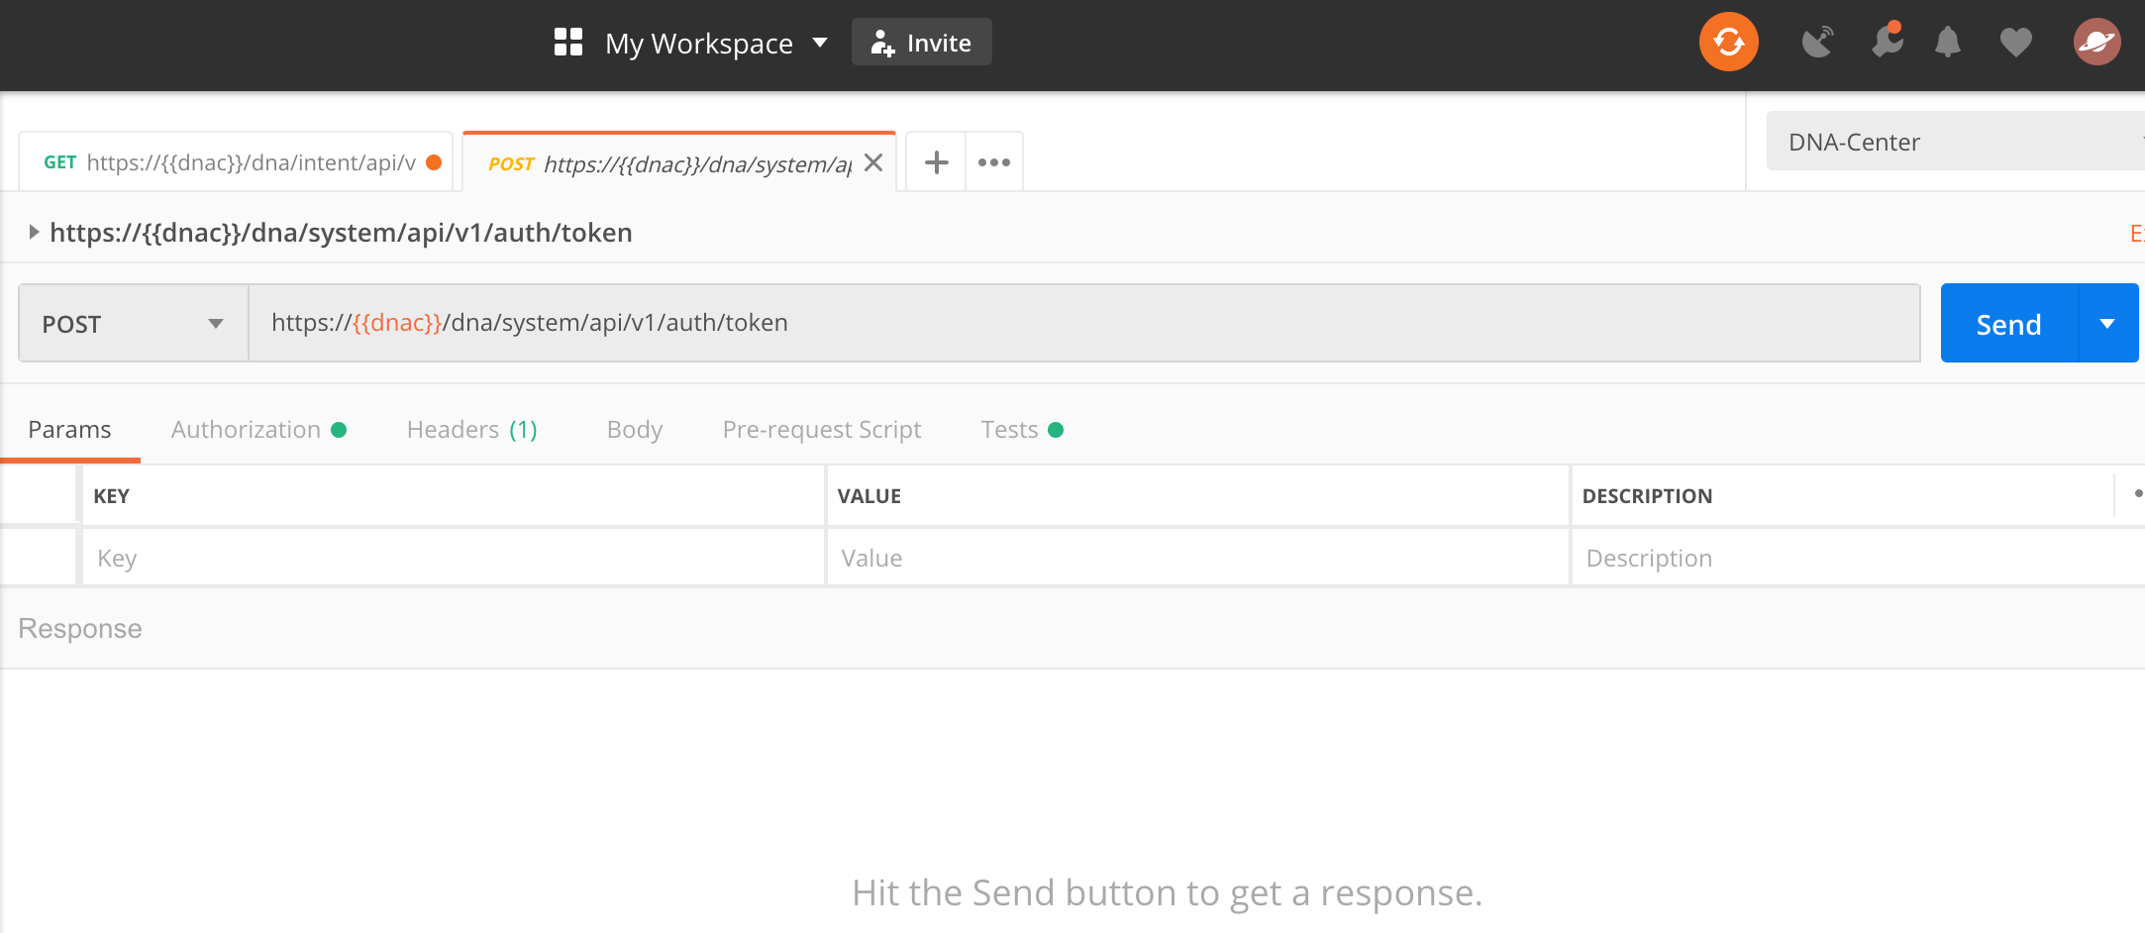
How to run API calls?
Option 3 – CURL / Postman
DEVNET-2087

Slide 23
Intent API – Available categories
Authentication
Know your network
Site Management
Connectivity (added in 1.2.8)
Operational Tools
DEVNET-2087

Slide 24
DNA Center – Intent API
Authentication
Authentication APIs provide an authorized token for accessing any REST API.
*Prerequisite*: Add the request header ‘x-auth-token’ with the generated authorized token to get a successful API response.
DEVNET-2087

Slide 25
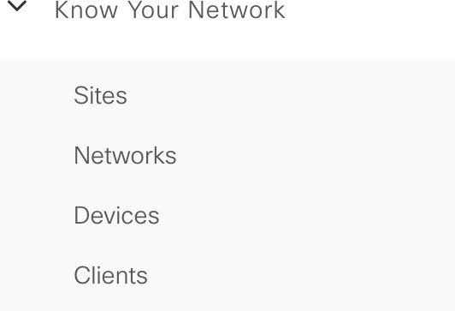
DNA Center – Intent API
Know your network
“Know your network” API can be used to discover details about clients, sites, topology and devices,
also: it provides programmatic REST APIs to add devices to the network and export device data.
DEVNET-2087

Slide 26
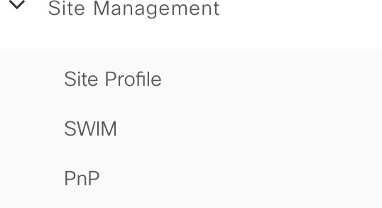
DNA Center – Intent API
Site Management
allows provisioning enterprise networks with zero touch deployment,
manages the activation and distribution of software images in the network.
DEVNET-2087

Slide 27
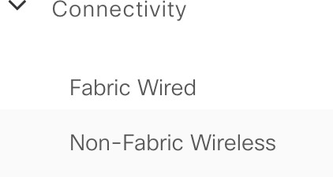
DNA Center – Intent API
Connectivity
allows managing fabric devices in SD-Access fabric and non-fabric wireless
devices.
DEVNET-2087

Slide 28
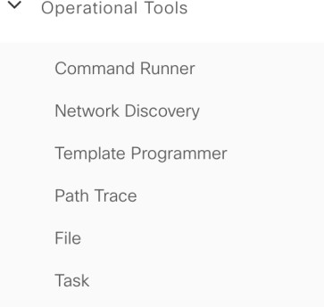
DNA Center – Intent API
Operational Tools
allows configuring & managing CLI templates and running commands,
provides support for network devices discovery,
supports path trace functionality in the network.
DEVNET-2087

Slide 29

Demo

Slide 30

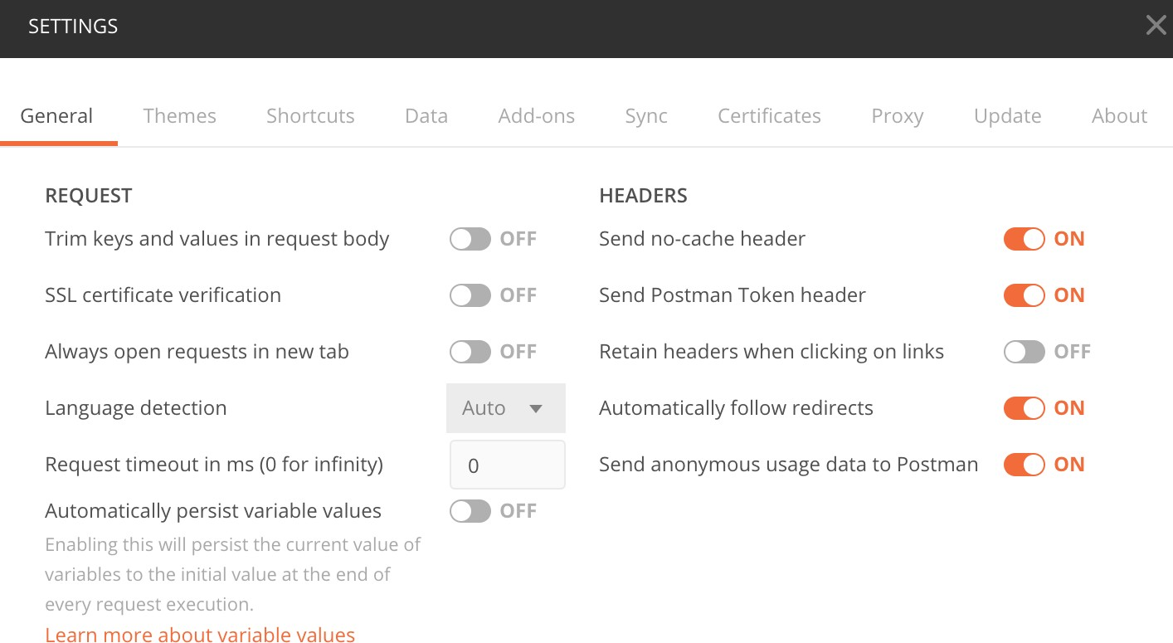
Postman – self-signed certificates
Must be set to ”OFF” if DNA-Center uses self-signed certificate.
DEVNET-2087

Slide 31
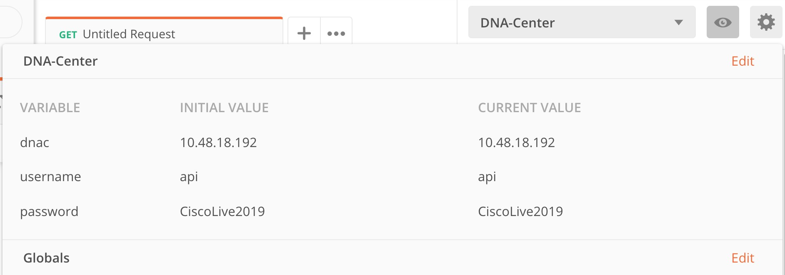
Postman – local variables
DEVNET-2087

Slide 32
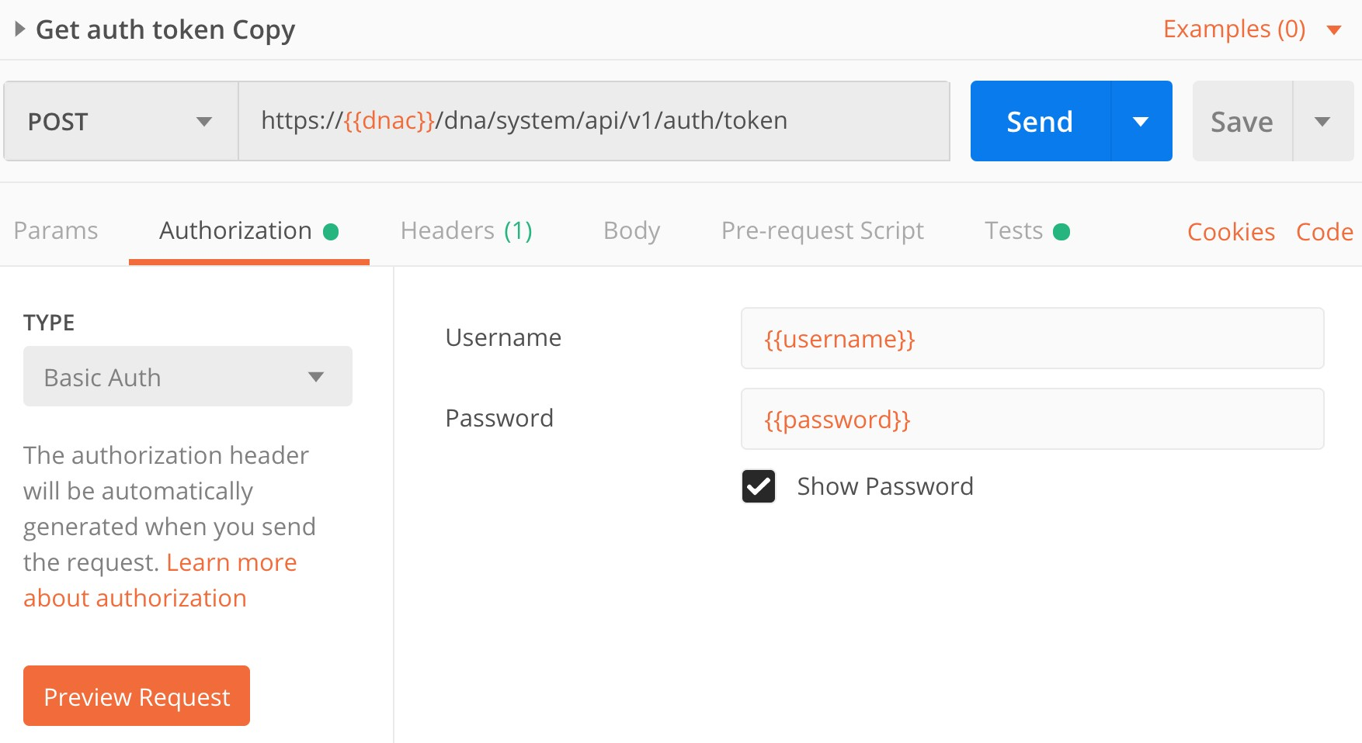
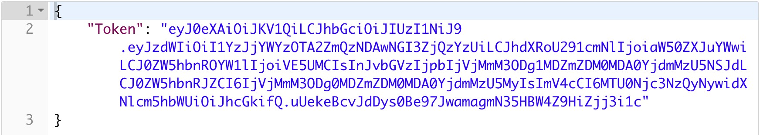
Postman – get auth token
Send POST request to get
token
1
Get Token from
response
2
DEVNET-2087

Slide 33
DEMO
get device details
DEVNET-2087

Slide 34
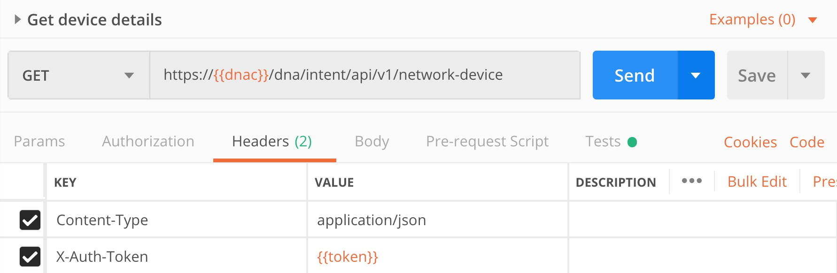
Postman – get device details
DEVNET-2087

Slide 35
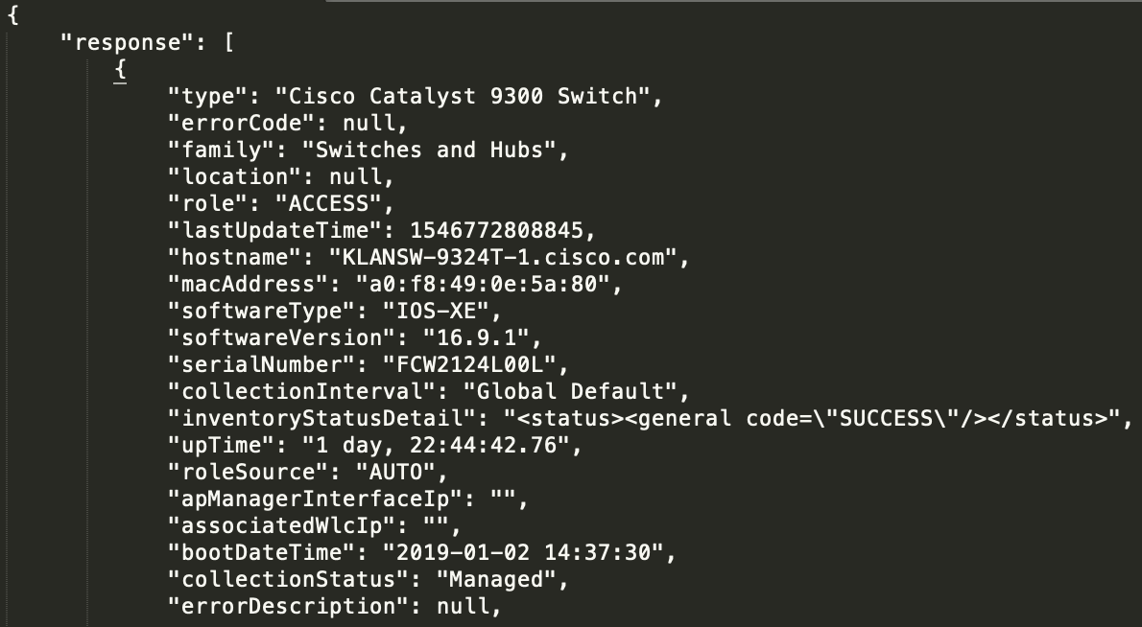
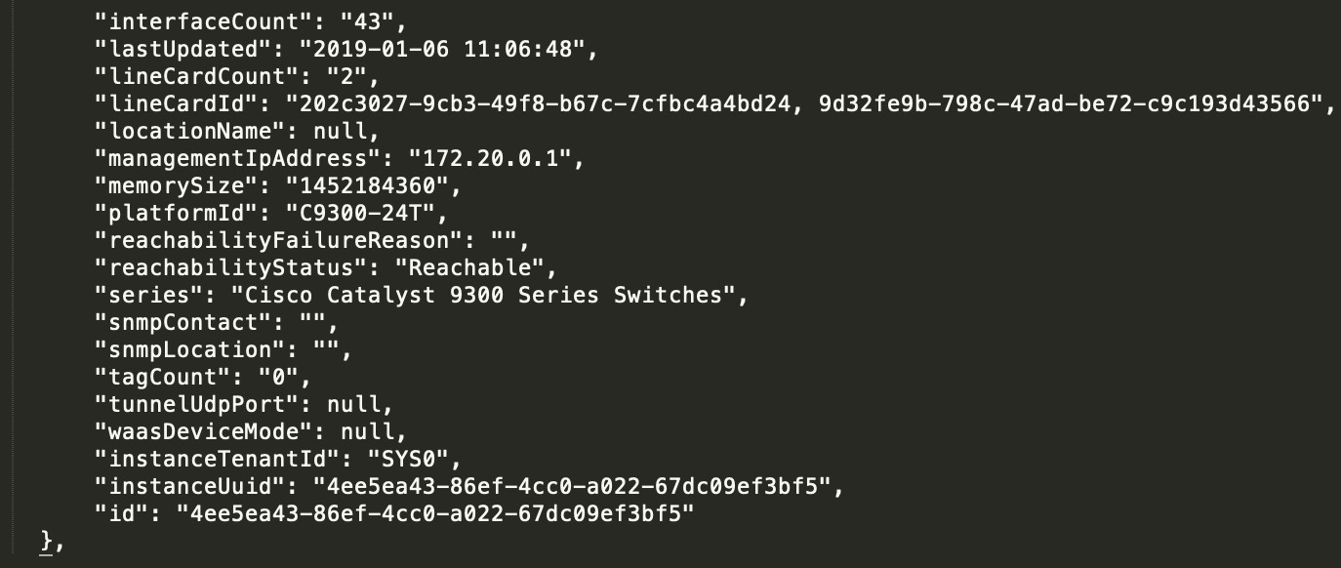
Postman –device details (response)
DEVNET-2087

Slide 36
DEMO
get CLI outputs from devices
DEVNET-2087

Slide 37
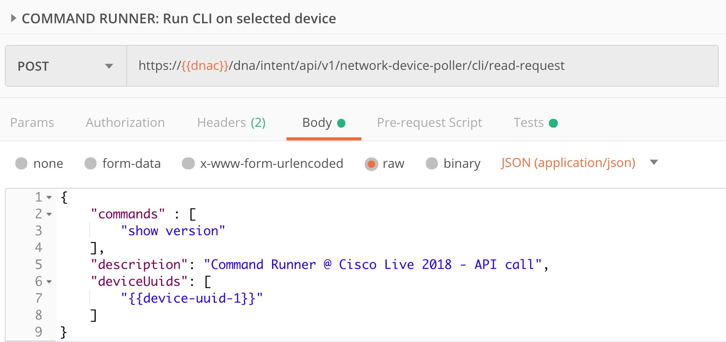
Postman –get CLI outputs
Device UUID(s) taken from
previous ouput (get device details)
DEVNET-2087

Slide 38
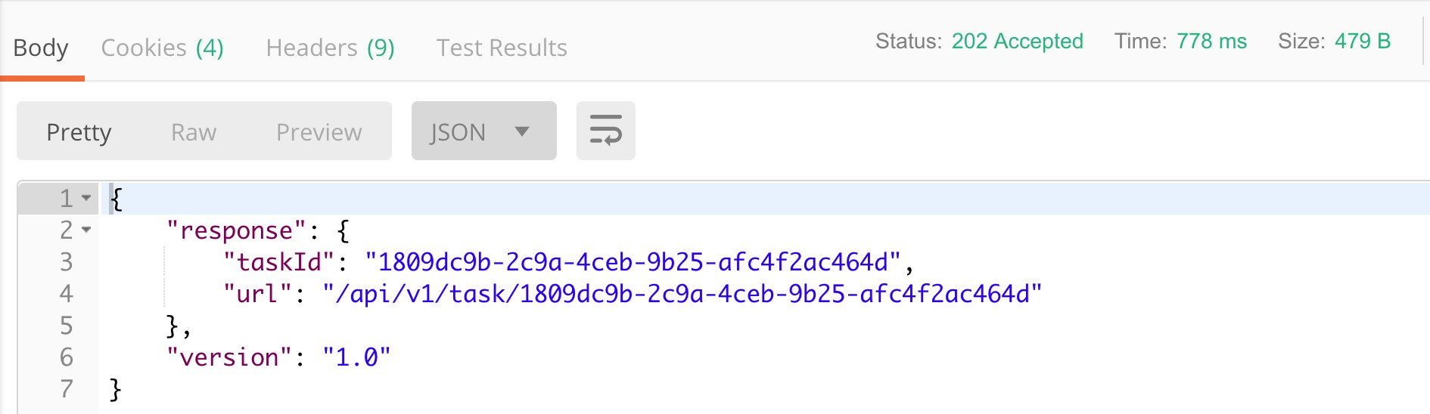
Postman –get CLI outputs (response)
Async request: URL for task is returned
instead of CLI output. Stored in Postman in
{{cli-read-url}} variable.
DEVNET-2087

Slide 39
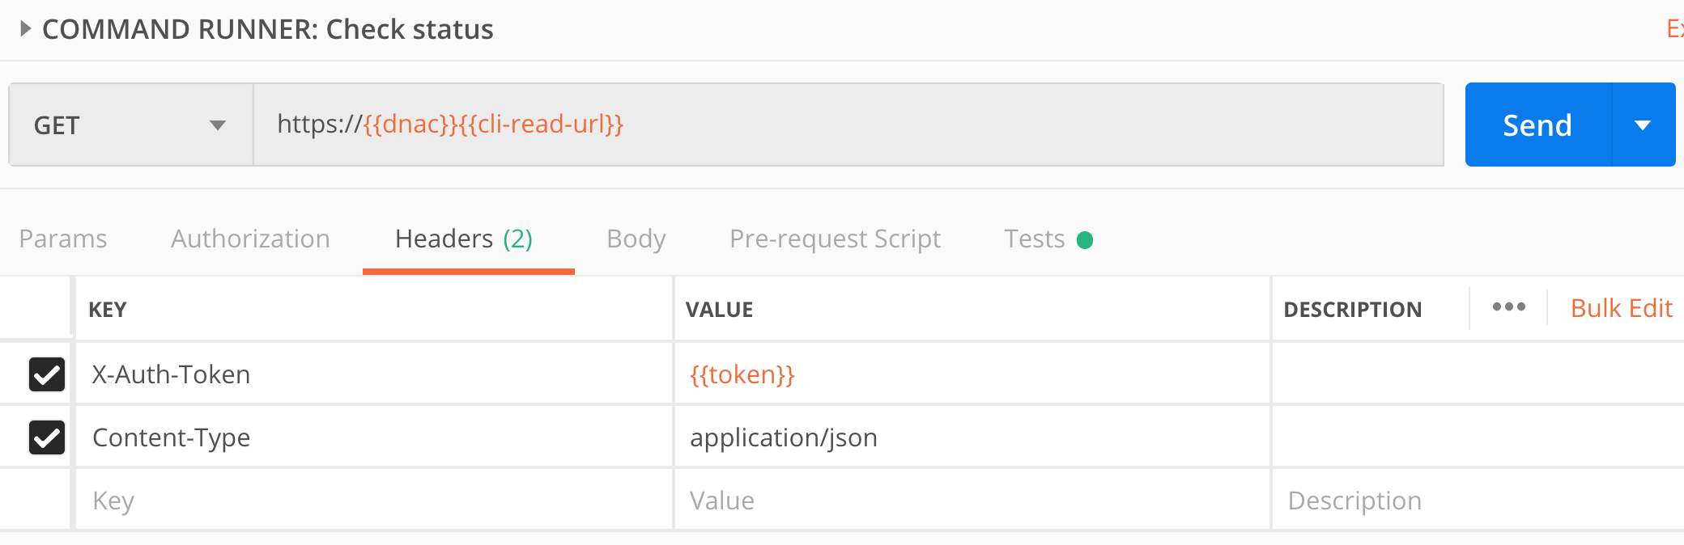
Postman –check task status
Variable {{cli-read-url}} is taken from the previous output.
DEVNET-2087

Slide 40
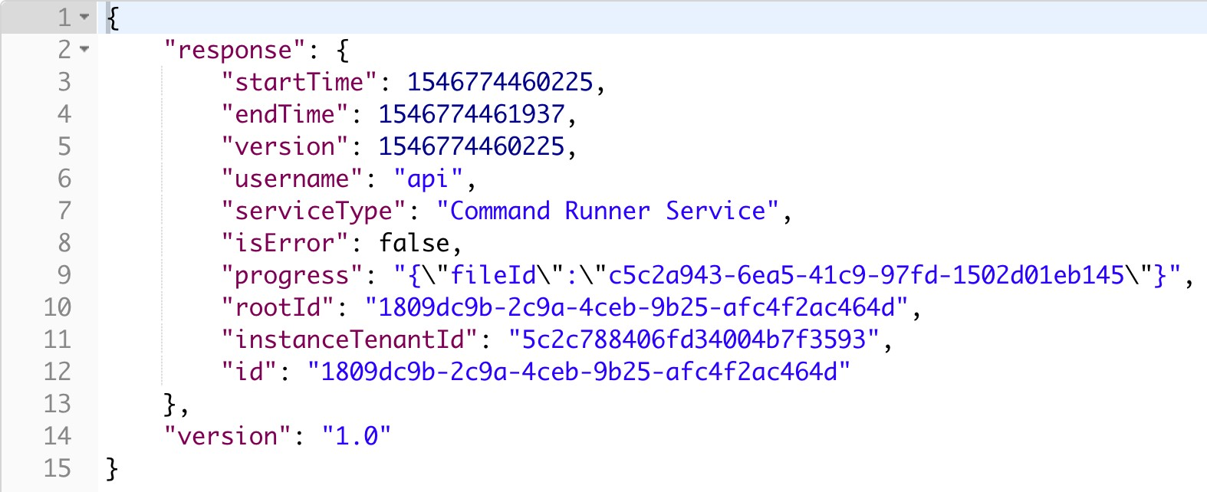
Postman –check task status (response)
If successful, then fileId is returned
with the CLI output
DEVNET-2087

Slide 41
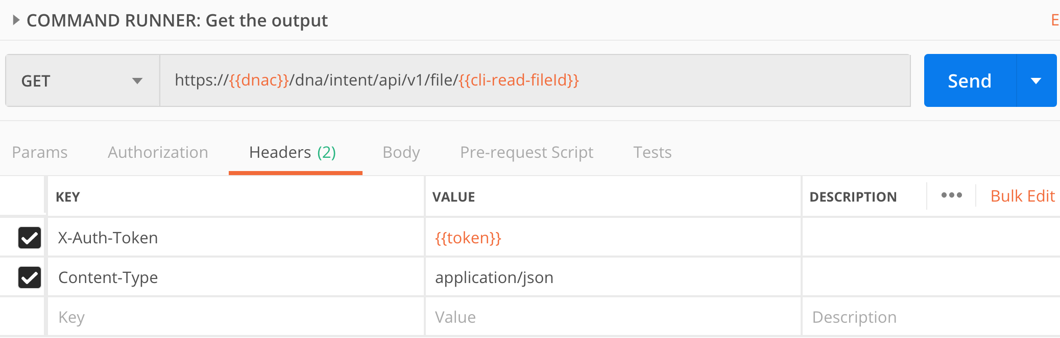
Postman –get fileId content
Variable {{cli-read-fileld}} corresponds
to fileId from the previous output
DEVNET-2087

Slide 42
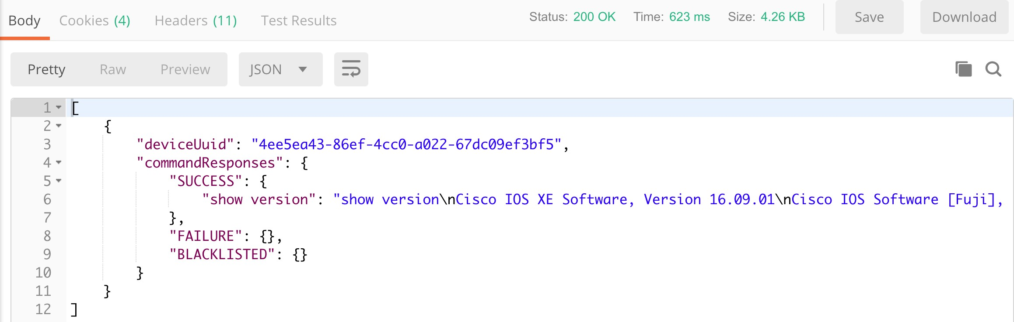
Postman –get fileId content (response)
Output of requested CLI returned
via fileId request.
DEVNET-2087

Slide 43
DEMO
manage software images
DEVNET-2087

Slide 44
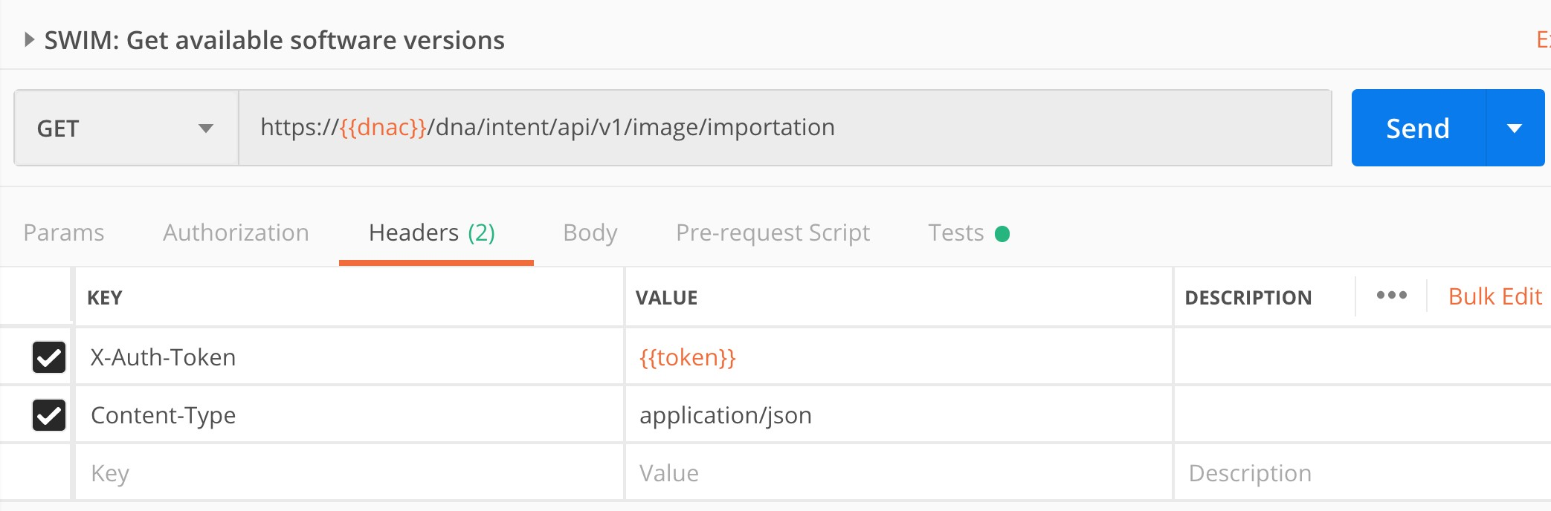
Postman –get available software images
DEVNET-2087

Slide 45
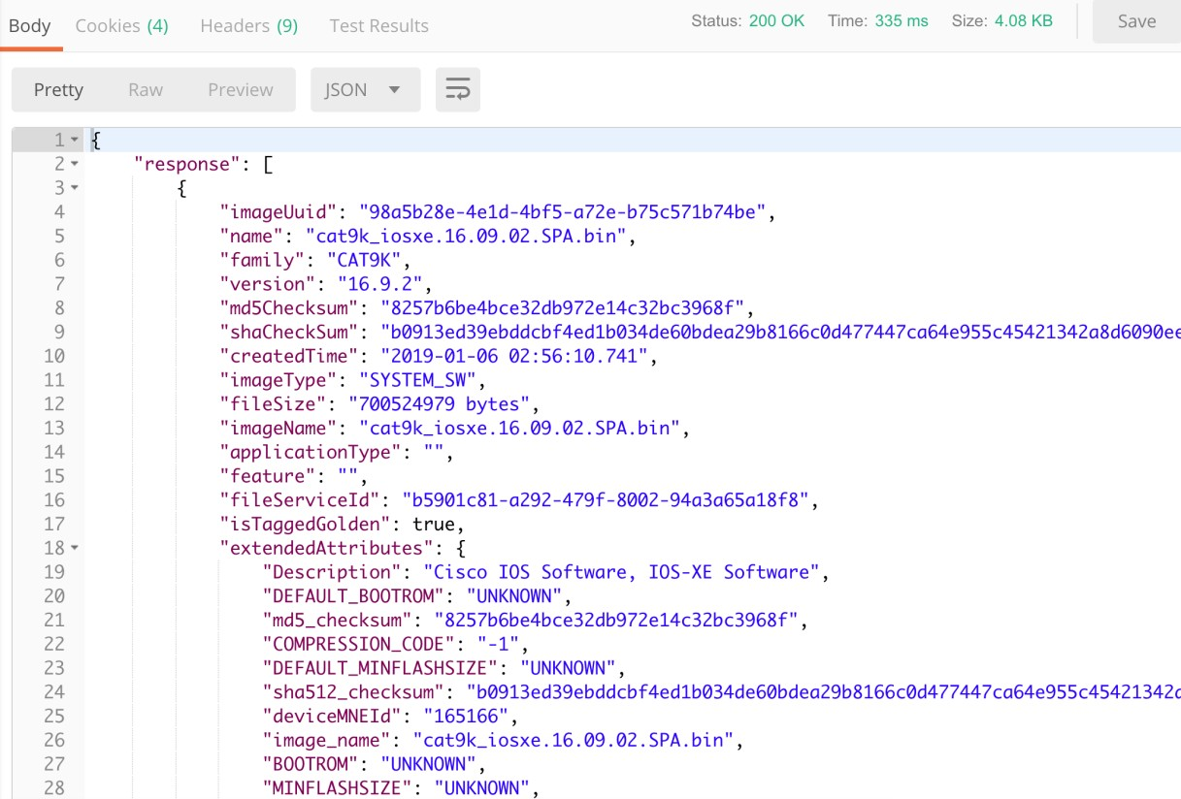
Postman –get available software images (response)
DEVNET-2087

Slide 46
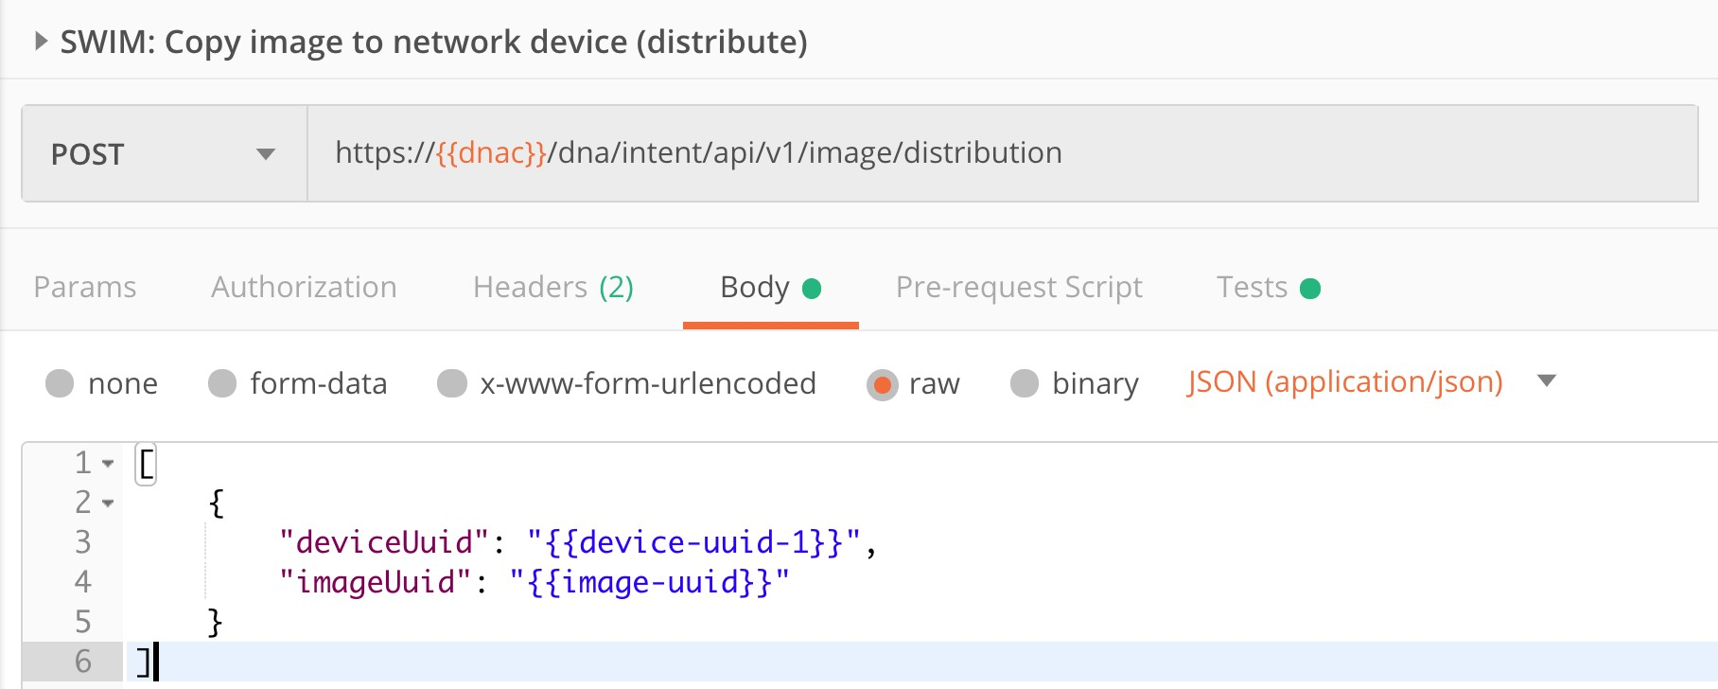
Postman –copy image to device
DEVNET-2087

Slide 47
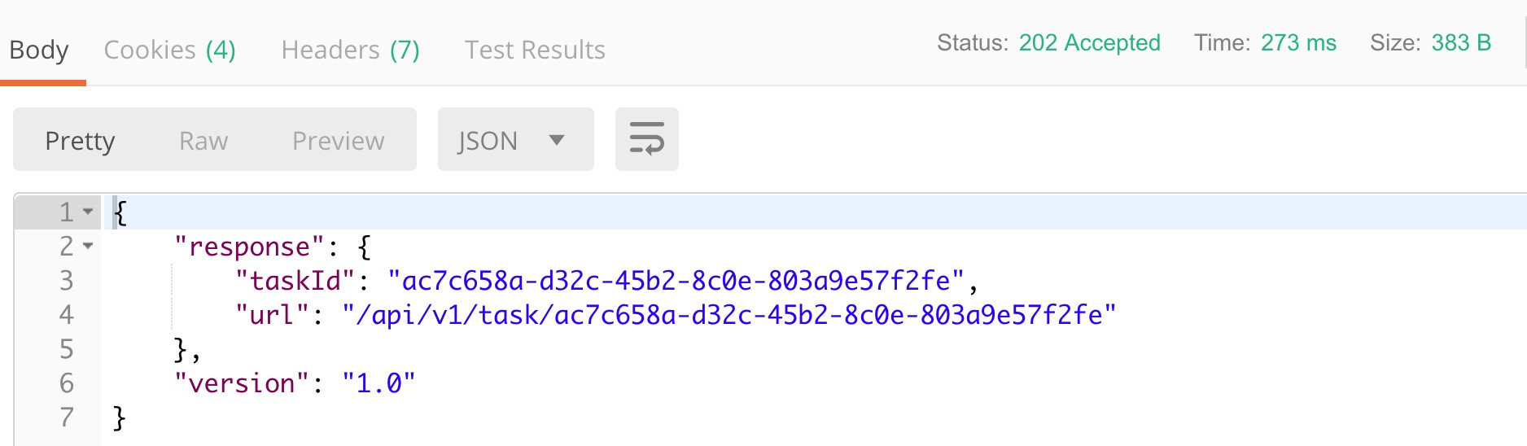
Postman –copy image to device (response)
Async request: URL for task is returned
instead of task status. Stored in Postman in
{{swim-task-url}} variable.
DEVNET-2087

Slide 48
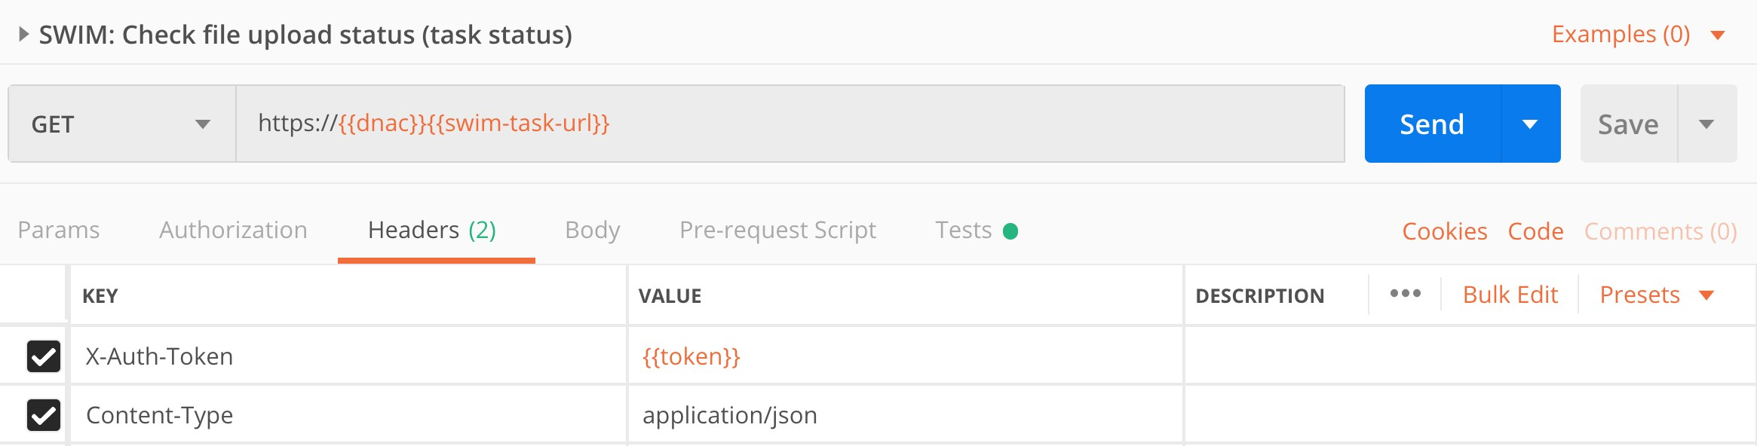
Postman – check task status
Checking task status is common in Cisco DNA-Center Same (same logic was already used for ”Command Runner” on previous slides)
DEVNET-2087

Slide 49
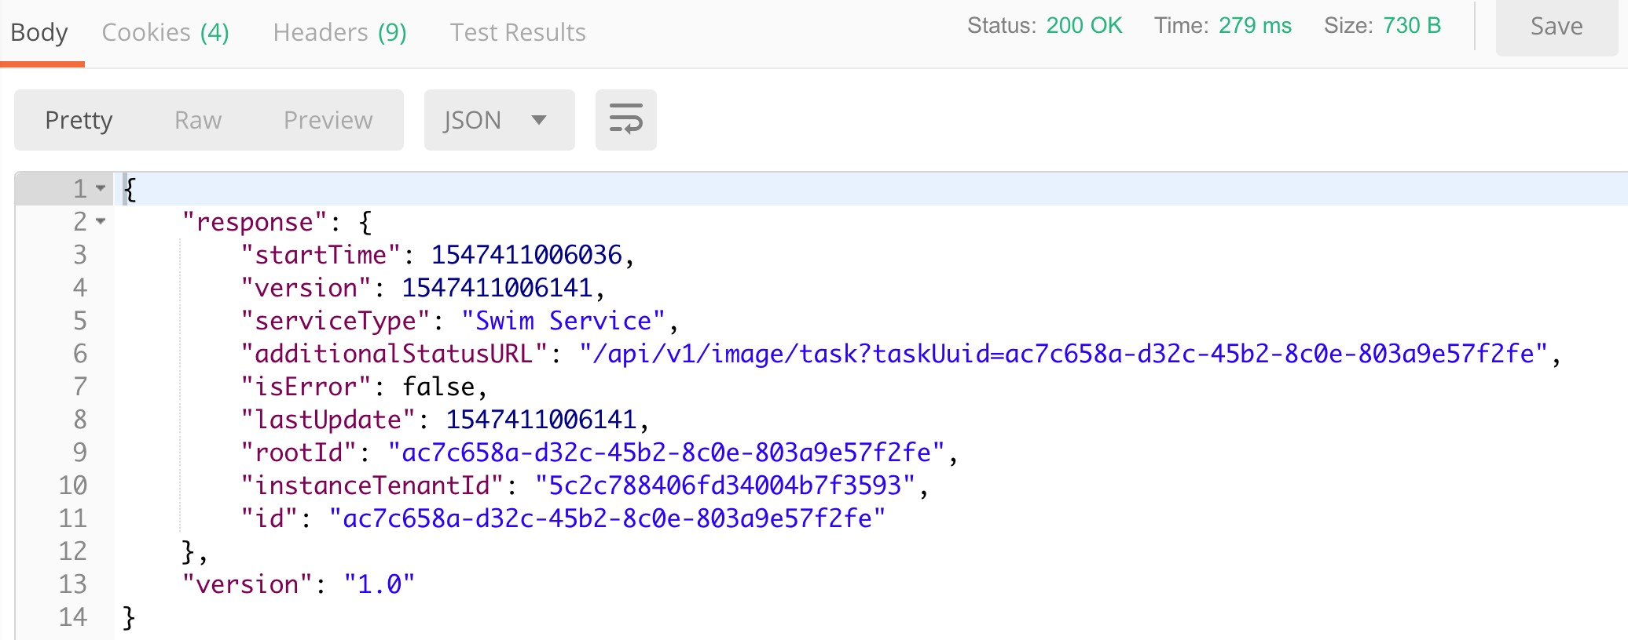
Postman – check task status (response)
Async request: URL for additional task status
is returned and stored in Postman in
{{swim-url-extra-details}} variable.
DEVNET-2087

Slide 50
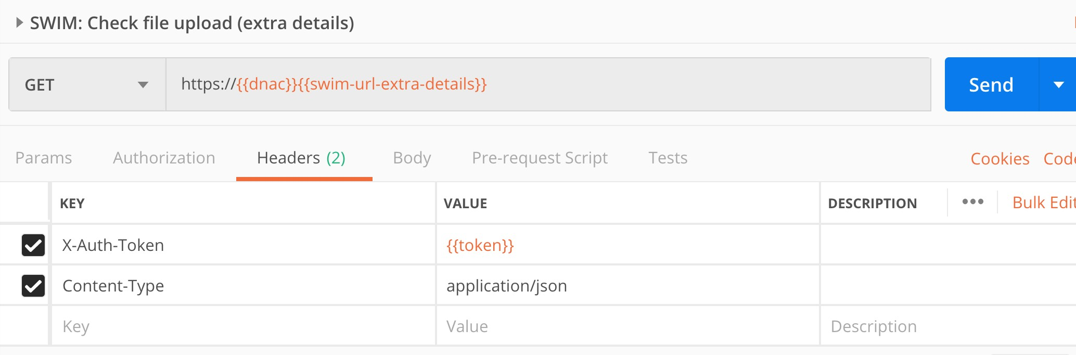
Postman – additional details
Variable {{swim-url-extra-details}} is taken from the previous output.
DEVNET-2087

Slide 51
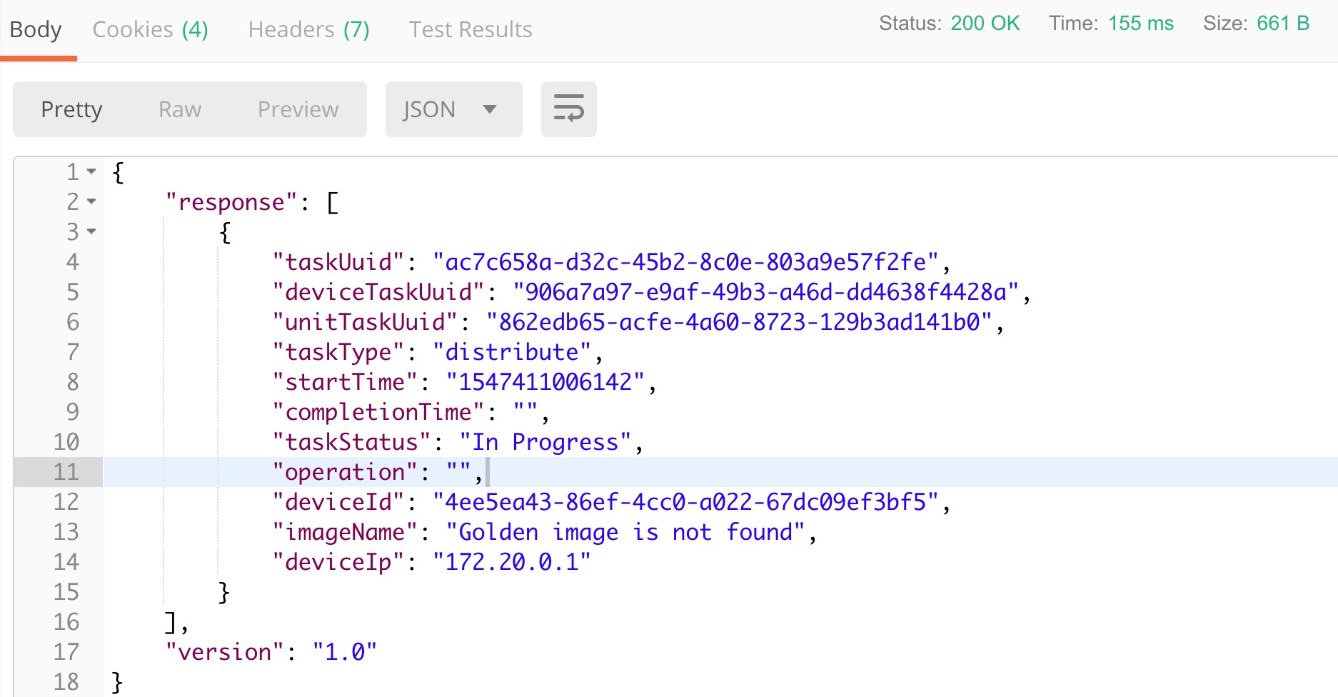
Postman – additional details (response)
DEVNET-2087

Slide 52
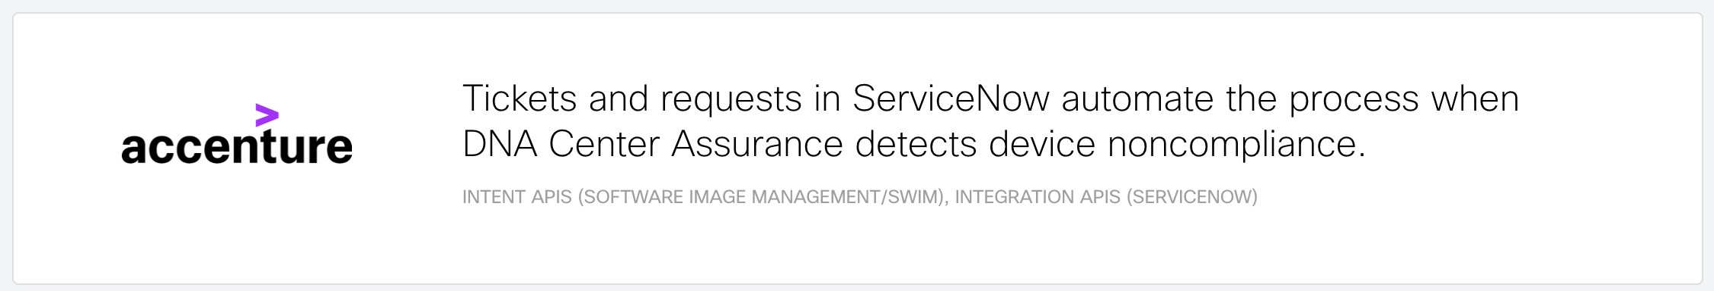
Intent API in action
DEVNET-2087

Slide 53
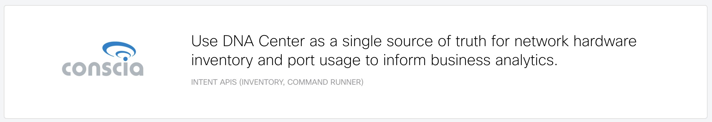
Intent API in action
DEVNET-2087

Slide 54

Intent API in action
DEVNET-2087

Slide 55
How to start?
I have a Cisco DNA Center
Install Cisco DNA-Center Platform
Enable REST API bundle
FUN TIME ☺
DEVNET-2087

Slide 56
How to start?
I need a Cisco DNA Center
Always-on sandbox (shared)
Reservation-based sandboxes (dedicated)
FUN TIME ☺
DEVNET-2087

Slide 57
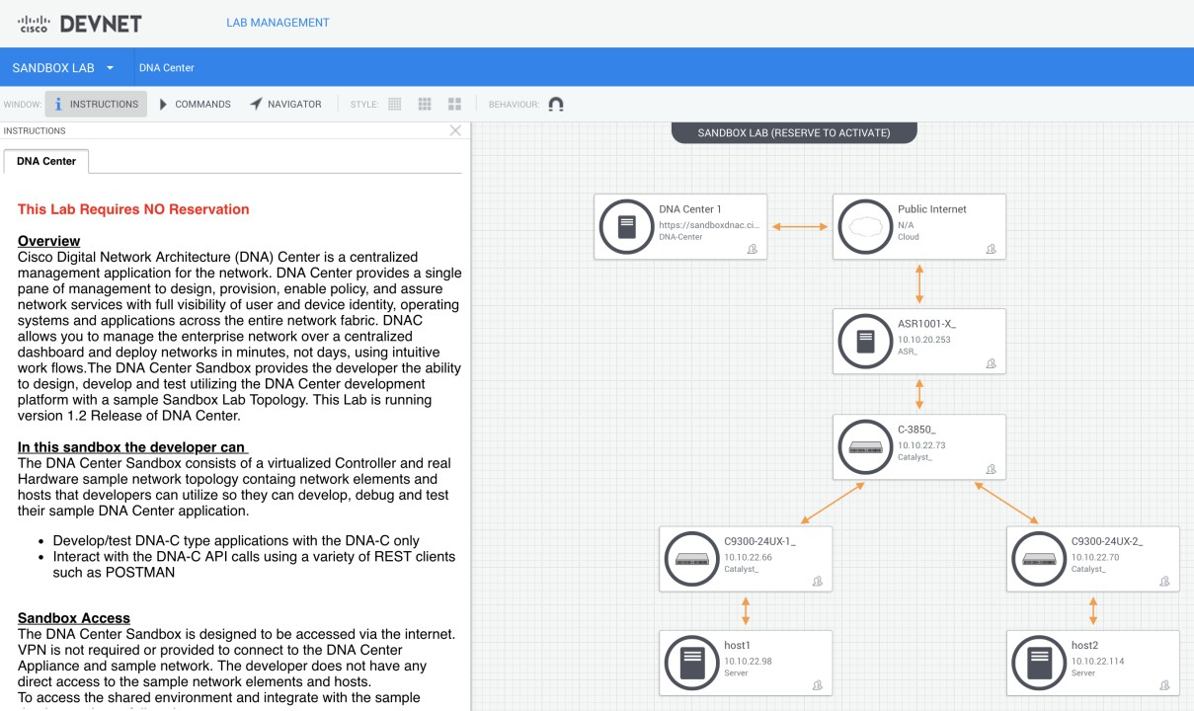
Cisco DNA-Center
always-on sandbox
https://devnetsandbox.cisco.com
DEVNET-2087

Slide 58
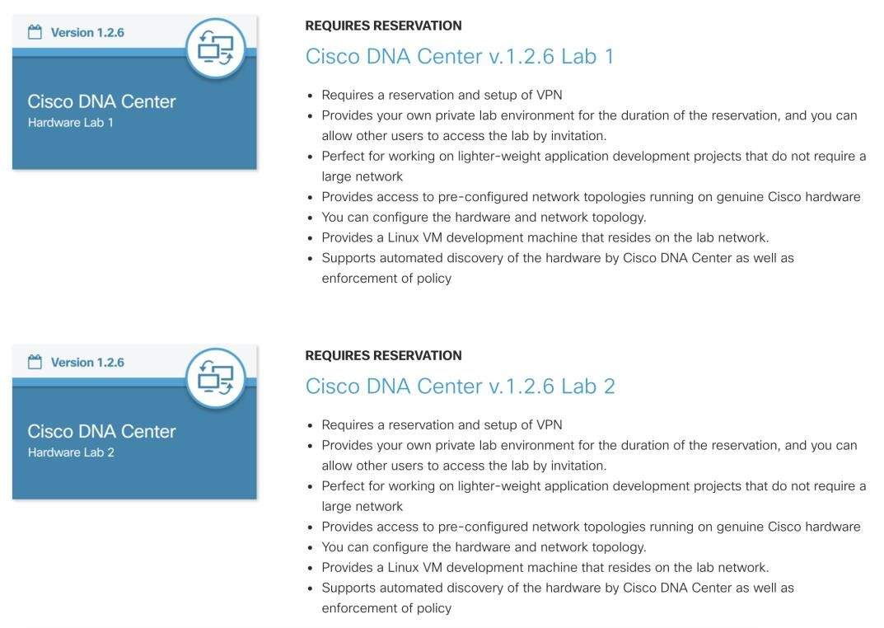
Cisco DNA-Center
reservation-based sandboxes
https://developer.cisco.com/docs/dna-center/#!cisco-dna-center-sandboxes/cisco-dna-center-sandboxes
DEVNET-2087

Slide 59
Reference materials
DevNet – Cisco DNA-Center:
https://developer.cisco.com/dnacenter/
DevNet – Intent API – overview:
https://developer.cisco.com/dnacenter/intentapis/
DevNet – Cisco DNA-Center – Intent API (docs):
https://developer.cisco.com/docs/dna-center/#!cisco-dna-center-platform-overview/intent-apis
DEVNET-2087

Slide 60
Complete your
online session
Please complete your session survey
after each session. Your feedback is very important.
Complete a minimum of 4 session surveys and the Overall Conference survey (starting on Thursday) to receive your Cisco Live water bottle.
All surveys can be taken in the Cisco Live Mobile App or by logging in to the Session Catalog on ciscolive.cisco.com/us.
Cisco Live sessions will be available for viewing
on demand after the event at ciscolive.cisco.com.
evaluation
DEVNET-2087

Slide 61





Continue your education
Demos in the Cisco campus
Walk-in labs
Meet the engineer 1:1 meetings
Related sessions
DEVNET-2087

Slide 62
Thank you

